Slide 1
Opening an Italian Restaurant in Toronto
IBM Applied Data Science Capstone Project
By Sanjay Pramanik

Slide 2
Background and Problem Statement
A friend wants to open an Italian restaurant in Toronto.
He wants to find a location with little or no competition.
Data from various sources, such as Wikipedia, Four square etc. can be used for the project.
Problem statement: Finding neighbourhoods in Toronto with little to no Italian restaurants.

Slide 3
Data Collection
The following sources will be used:
Wikipedia will be used to extract neighbourhood data for Toronto.
The geospatial data from COCL will be used to find the coordinates of the different neighbourhoods.
The Foursquare API will be used to find venues on different locations and to find the neighbourhoods with little or no Italian restaurants.
The folium application in Python will be used to map the data and give an overview of the neighbourhoods.

Slide 4
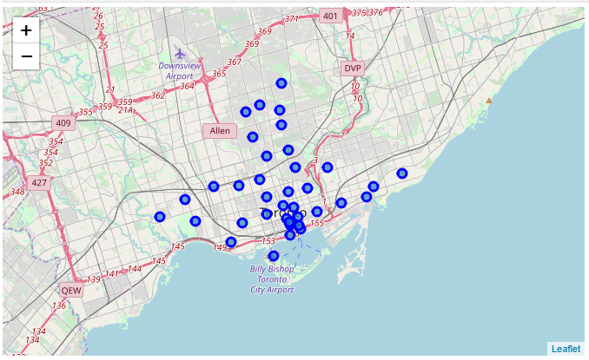
Methodology – Data preparation
The data was cleaned. Boroughs that were ‘Not assigned’ were deleted, as well as ‘Not Assigned’ neighbourhoods.
The latitude and longitude were merged with the neighbourhood data.
The neighbourhoods were mapped:

Slide 5
Methodology – Connecting to Foursquare
All venues from the different neighbourhoods were extracted using the Foursquare API.
The column Italian Restaurant was selected and sorted by frequency.
From the initial 103 rows, 28 rows remained with little or no presence of Italian Restaurants. This was presented in a map.

Slide 6
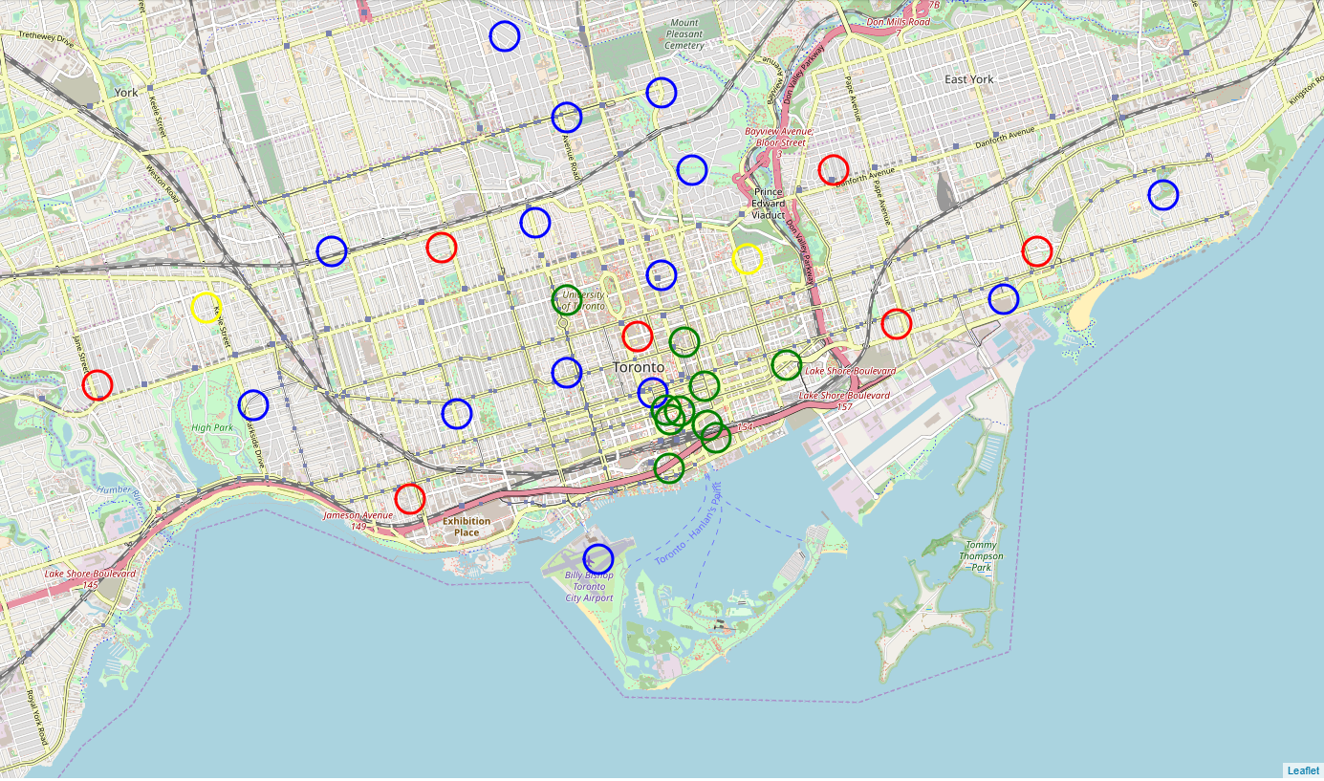
Results
The following map shows the desirable and undesirable neighbourhoods.
Red=high frequency of Italian restaurants
Yellow=medium frequency of Italian restaurants
Green= Low frequency of Italian restaurants
Blue=no frequency of Italian restaurants

Slide 7
Discussion
The neighbourhoods with little or no Italian restaurants have been identified, but we did not look at reviews, demography, etc.
The client was asking for neighbourhoods with almost none or no Italian restaurants, this might not be the best tactic. It might be better to look at a location with a lot of Italian restaurants that are not excellently rated and try to become the best Italian restaurant in that area.
Now 28 neighbourhoods are selected, the client should come up with more requirement in order to make a more specific selection.

Slide 8
Conclusion
Data science in python is Fun

